Slide 1
115kV / 34.5kV Solar Power Plant/Substation Design Project
Team sdmay19-26
Nur Shuazlan, Tam Nguyen, Ahmed Sobi, Katayi Katanga, Yao Jiang Cheah, Chufu Zhou
Advisor: Dr. Ajjarapu
Client: Black & Veatch
http://sdmay19-26.sd.ece.iastate.edu/
Notes:
Title slide (title, team, advisor, and client info)

Slide 2
Black & Veatch Information
A global engineering, construction and consulting company which specializes in infrastructure development for power, oil and gas, water, telecommunications, government, mining, and banking and finance markets.
The largest majority employee-owned company in the U.S, and is ranked by Forbes as one of the largest privately owned companies.
A large amount of its revenues comes from power.

Slide 3
Project Plan
Notes:
Problem Statement
Conceptual Sketch
Functional Requirements
Non-functional Requirements
Technical/Other Constraints/Considerations, Market survey – articulate what makes your project unique
Potential Risks & Mitigation , Resource/Cost Estimate , Project Milestones & Schedule

Slide 4
Problem Statement
General Problem:
An increasing need for a growth in the use of renewable energy to reduce enhanced greenhouse effect
Prevent high power loss for long distance transmission
The Renewable Energy Standards (RES) allow companies to push more toward renewable energy
Solution:
Design a 60 MW solar plant and a 115kV/34.5kV substation

Slide 5
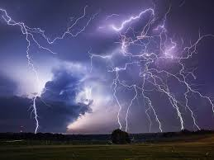
Operating Environment
Substation and plant must be able to withstand any extreme weather conditions they will be subjected to in Estancia, New Mexico, and must be able to do so for a long time.
The design is equipped with all of the necessary protection devices in order to withstand any abnormal voltages that are expected.

Slide 6
Possible Risks
Defect on components
Electric shock
Electric shock upon substation installation
Our design does not include substation grounding

Slide 7
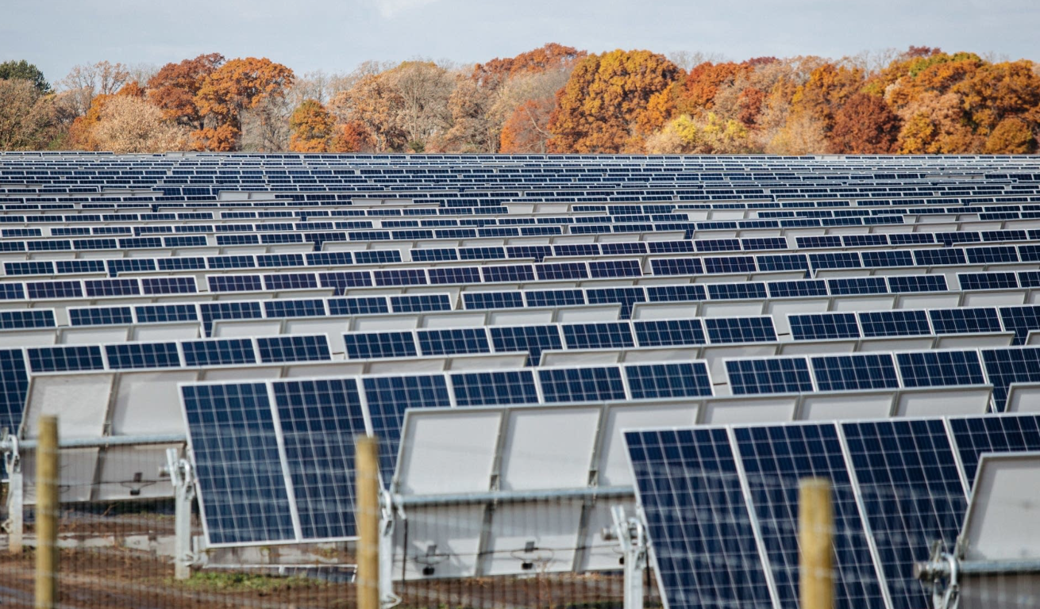
Market and Literature Survey of Similar Products
MISO North Star Solar Project 100 MW capacity:
Location in Saint Paul, MN
100 MW of solar PV capacity(440,000 solar panels)
Approximately 800 acres of agricultural land
Single axis tracking technology to maximize production
Grid connection at the Chisago County substation 115kV

Slide 8
System Block Diagram
Notes:
The solar racks consist of 238032 solar panels which generate DC power.
The panels are connected to strings and each string has 19 panels connected to it.
To bring several Solar strings output together and consolidate incoming power into main feed we will be using about 792 CBs.
To convert the combined output voltage from DC to AC the plant will have about 36 inverters and each inverter will be attached to step-up transformer.
We will have three feeders that’s carrying about 409 A each, attached to 34.5 KV bus.
At the end the substation will have another step-up transformer to raise the voltage to 115 KV transmission level.

Slide 9
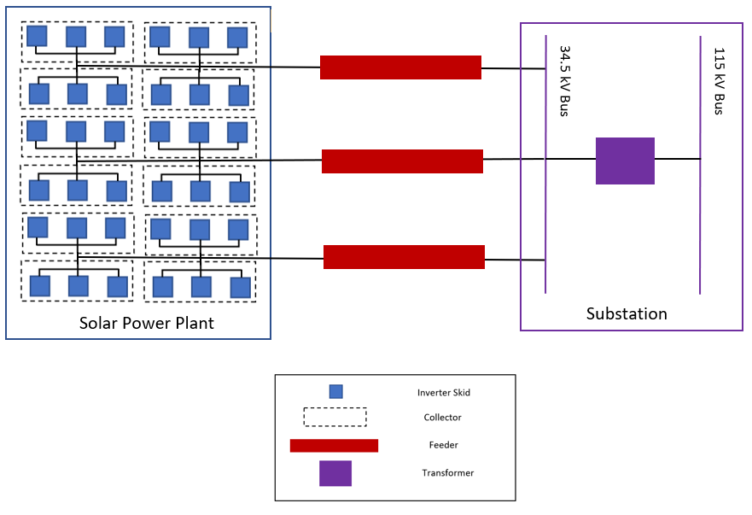
Conceptual Sketch

Slide 10
Requirements (Functional/Non-Functional)
Location of solar plant and substation
Meet specifications set by the client
DC Voltage: 1000 V
Inverter: Eaton 1666kW
Panel: Hanwha 325W
ILR: 1.30
Fixed rack system
Solar power plant array design
Voltage drop calculations
Substation diagrams
Relays and controls
3 phase drawings
Communications
Notes:
Despite the fact that the specifications are specified by Client, we did went through the justification for solar panels, and the types of rack system

Slide 11
Deliverables
Man Hour Budget
Solar plant design
Location
Number of components and total cost
Plant layout
Wiring and conductor sizing
Substation Design
Feeder and collector diagrams
Key protection Diagram
AC drawings
Relay diagrams
Communication diagrams

Slide 12
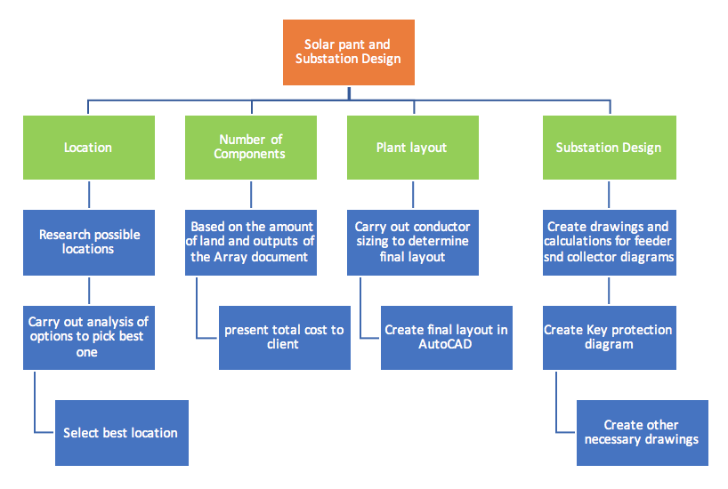
Project Plan: Workflow Diagram
Notes:
Tam

Slide 13
Resource Requirements
Solar Power Plant
Equipment
238,032 solar panels
792 combiner boxes
36 inverters
Conductors/Cables
244 acres of land
We found a 560-acre land for sale for $195,000
Substation
Equipment
12 collectors
3 feeders
Surge arrestors
Transformers
Conductors/cable
Notes:
Tam

Slide 14
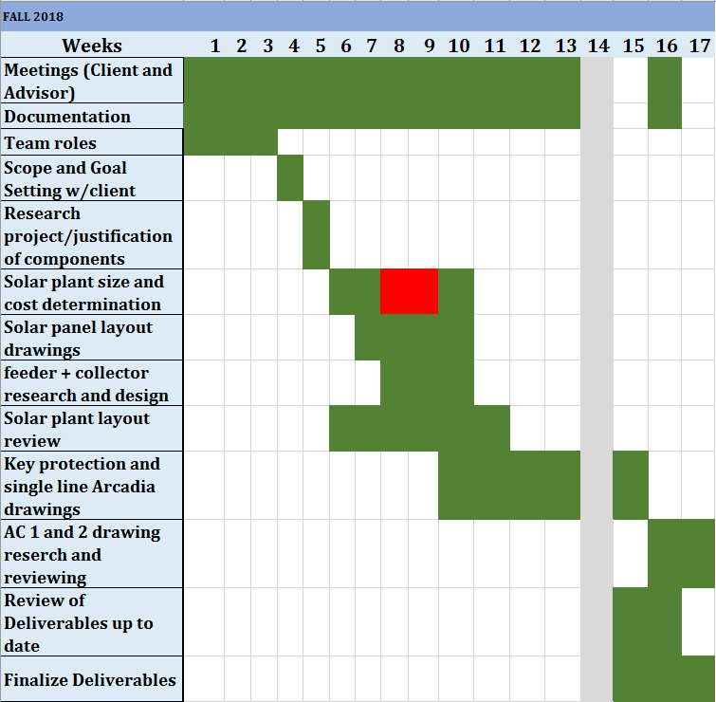
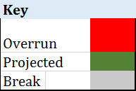
Project Schedule For Fall 2018
Notes:
Tam

Slide 15
System Design

Slide 16
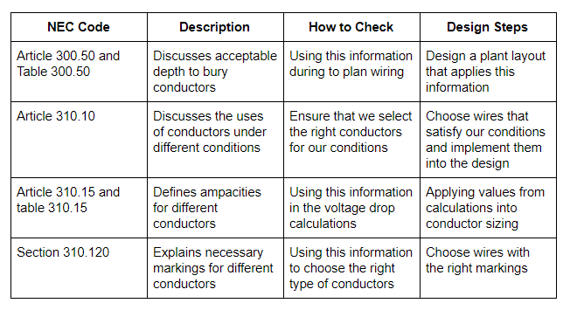
System Requirement
Compliance with the following NEC codes:
Notes:
Article 300.50, Table 300.50
Direct-Buried Cables under general condition
Voltage over 1000V through 22kV
750mm or 30inches underground for solar power plant
Voltage over 22kV through 40kV
900mm or 36inches underground for feeder line and up to the lowside of substation design that has 34.5kV
Voltage over 40kV
1000mm or 42inches underground, will be on highside of substation design

Slide 17
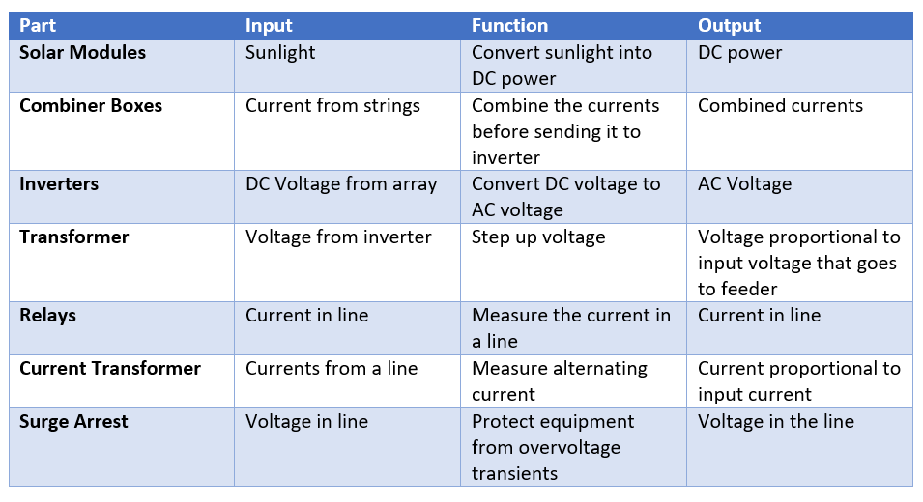
Functional Decomposition

Slide 18
System Analysis
Array parameter tool
Determine number of components and verify the voltage and power of the system
Voltage Drop Calculations
Carried out conductor sizing by analyzing the currents in the plant at different points.
Correspondence with seasoned engineers (Client)

Slide 19
Detailed Design
Notes:
Input/output specification
User interface specification
Hardware and/or software specifications

Slide 20
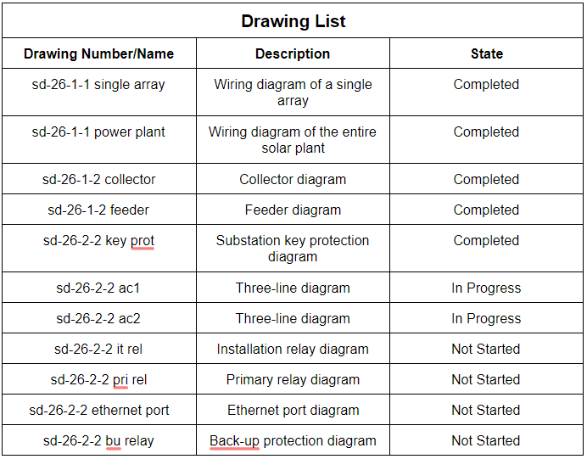
Overview of Designs
Notes:
User Interface
Utility companies
Software Specs
AutoCAD for drawing design
NREL System Advisor Model for solar plant analysis

Slide 21
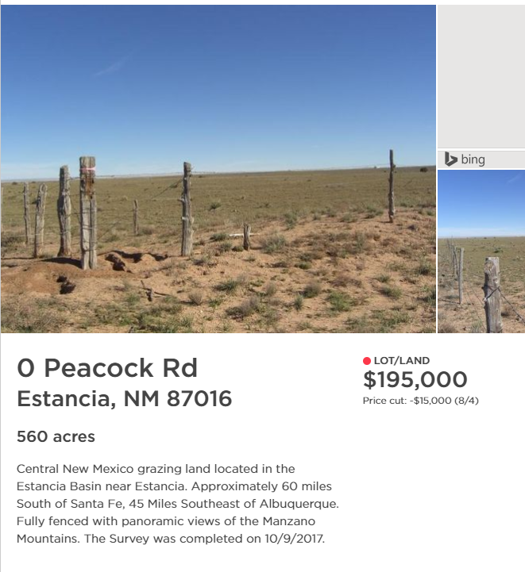
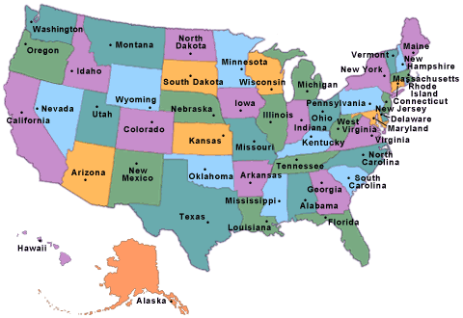
Location Decision
Notes:
We chose the location based on 9 factors: Solar radiation, Land size and price, Sunny days per year, Elevation, State financial incentives ranking, Total cost of solar power plant, Extra land for substation and expansion, More cost-effective than the rest of the Nation, and Distance to the nearest city/town.
We compare between 6 locations, and Estancia, NM was the best one.

Slide 22
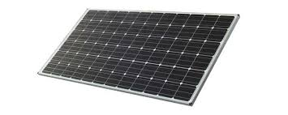
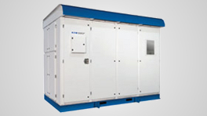
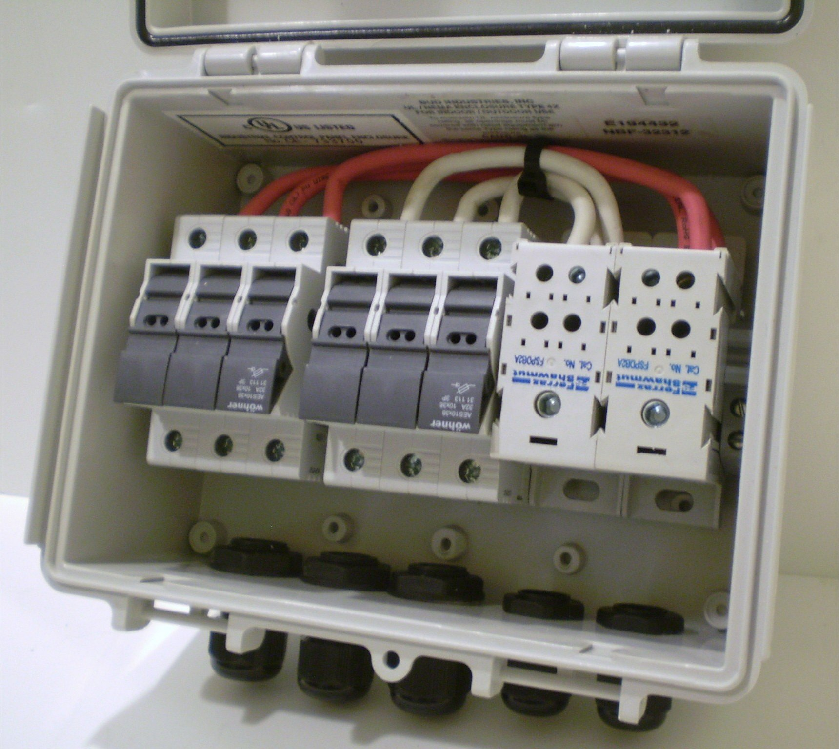
Solar Power Plant
Solar modules
Combiner boxes
Inverters
The solar plant generates, collects energy, and sends it to the substation.
Notes:
The solar plant will be made up of about 117 acres of land. It will be made up of:
238,032 solar modules with a rating of 325W per module.
36 inverters with a rating of 1666 kW .
792 combiner boxes with a rating of 1000 V DC.

Slide 23
Single Rack Layout

Slide 24
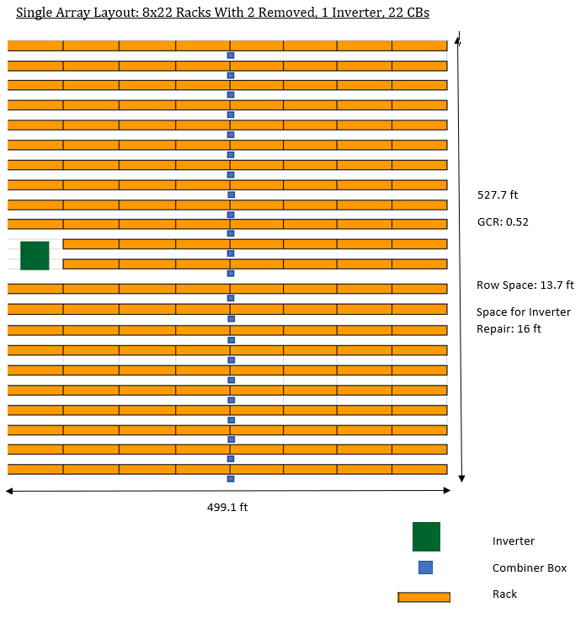
Single Array Layout

Slide 25
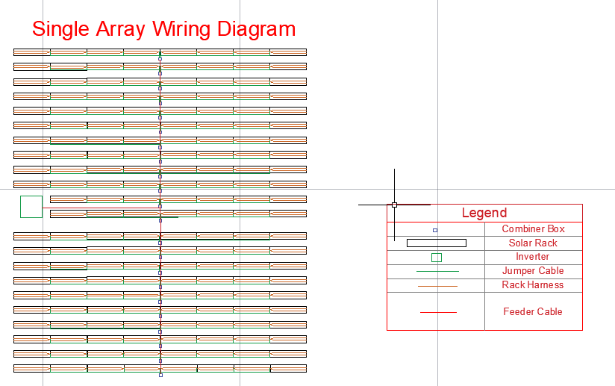

Slide 26
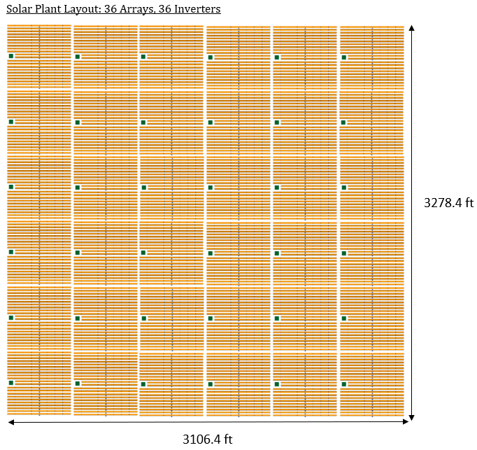
Solar Plant Layout

Slide 27
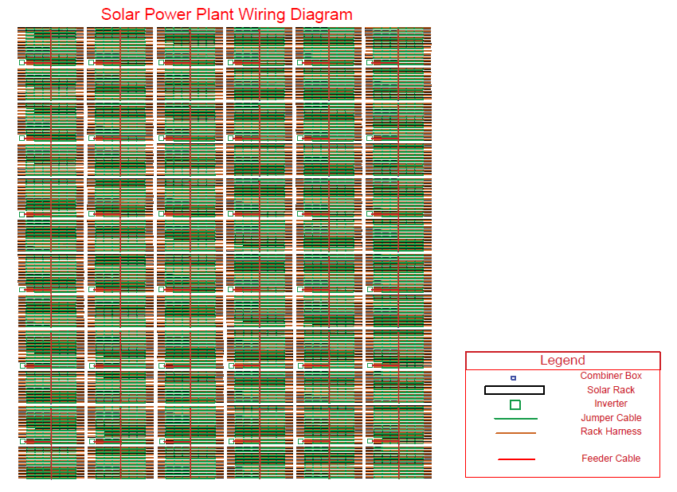

Slide 28
Substation
The one-line diagram
The key protection diagram
The three-line diagram
Protection and controls schematics
The substation steps up the voltage to reduce power loss during transmission and transfers the power to the main grid.
Notes:
Chufu

Slide 29
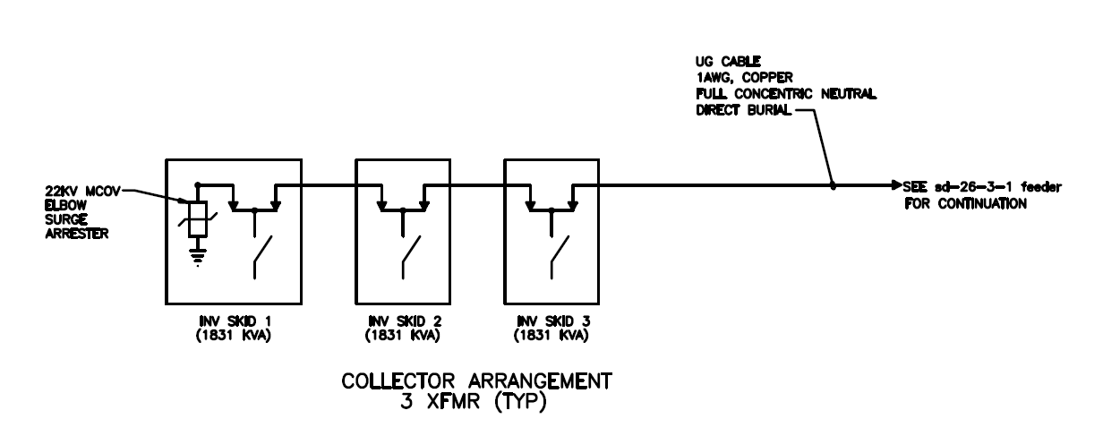
Notes:
A collector system is made up of three inverter skids, each of which contains an inverter and a step-up transformer. The inverter skid takes in the the DC power generated from the solar panels, convert it into AC power, and step up the voltage. A collector system then collects the total power generator from three inverter skids and feeds it into the substation via a feeder. There are three feeders, and each feeder is connected to four collectors. This means that there are a total of twelve collectors that are connected to the substation viz the three feeders.

Slide 30
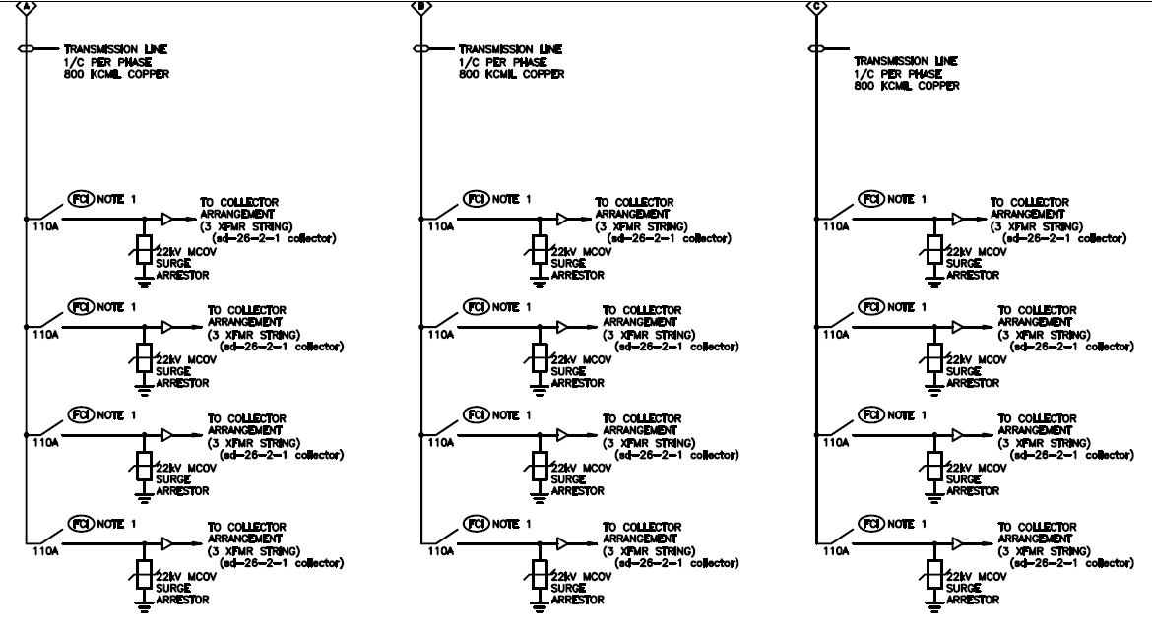
Notes:
Feeders take the output of the collectors and feed it to the 34.5 kV bus of the substation. There are a total of three feeders that are connected to the substation, and each feeder is connected to a circuit breaker and relay for control and protection purposes in case of fault currents.

Slide 31
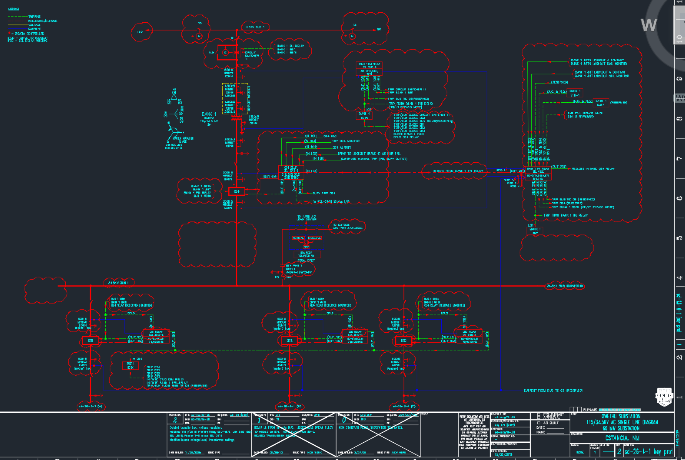

Slide 32
Testing Evaluation Plan
Array parameter tool:
Spreadsheet given by the client to determine the specification of the project.
Determine the number of (solar panels, combiner boxes, inverters)
We also use it to determine the ILR, the size of the plant, and the cost of the project.
Compliance with NEC codes:
Checking design against the codes specified
Calculating the conductor sizes and the voltage drop according the code.
Correspondence with Client :
Due to the nature of the project we used the client as a verification tool to monitor our progress and accomplishment.

Slide 33
Conclusion
Current project status with respect to milestones
Completed all the deliverables for this semester:
Substation one-line drawing and solar plant array layout/drawing
Engineering man-hour budget, project plan, design document, and team website. http://sdmay19-26.sd.ece.iastate.edu/
Notes:
Chufu

Slide 34
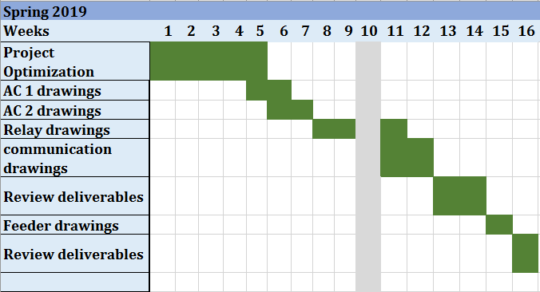
Plans For Next Semester
Notes:
Chufu

Slide 35
Thank You For Listening!
Any Questions?

